Slide 1


Deep Learning With NLP (AI6127): Stock Market Assistance
AI6127 Deep Learning With NLP Project
Notes:
Slide Title: Project Overview
Script:
"Today, I'm excited to introduce our project aimed at revolutionizing stock market analysis using advanced Natural Language Processing techniques. We're tackling the challenge of decoding the vast amounts of unstructured data from news articles and social media that influence market trends.
Our tool, powered by cutting-edge language models like Mistral and Gemma, simplifies complex financial data into easily understandable formats. Through innovative methods such as sentiment analysis and text summarization, we provide accessible, accurate market insights.
Our overarching goal is to democratize financial expertise by automating the extraction of actionable insights. By doing so, we aim to enhance individual investment strategies and broaden understanding of market dynamics without requiring deep financial knowledge."

Slide 2

Advancements in Data Augmentation
Current State
The Gap
Desired Outcome
Existing platforms oversimplify content, missing critical nuances
They are inefficient in detecting sentiment accurately
Despite the need for seamless integration across platforms, only a few apps offer such functionality, and they are typically paid.
Implementing efficient summarization techniques that capture critical nuances while condensing information into concise and informative summaries
Enhancing sentiment analysis accuracy by leveraging advanced techniques and models, ensuring that users receive reliable and actionable insights
We provide the integration in a user-friendly format, free of cost.
Lack of efficient summarization
Inaccurate sentiment analysis.This can lead to misleading insights and decisions, particularly in sensitive areas such as financial markets.
Limited availability of free, seamlessly integrated platforms.
Notes:
Slide Title: Improving Platform Capabilities
Introduction:
Today, let's dive into how content platforms are currently performing, pinpoint the gaps in their functionality, and discuss where we want to take them in the future.
Current State:
1. Content Oversimplification: Right now, a lot of platforms are guilty of oversimplifying content, missing out on crucial details that really matter.
2. Sentiment Analysis Woes: They're also not so great at accurately picking up on sentiment, which can lead to some serious misinterpretations, especially in tricky areas like finance.
3. Integration Hurdles: And when it comes to seamlessly integrating across platforms, there's a real shortage of options, with most of the decent ones being behind a paywall.
Obvious Gap:
1. Summarization Struggles: There's a clear need for better summarization techniques – we need to get better at distilling down complex information into bite-sized, understandable chunks.
2. Sentiment Slip-Ups: Sentiment analysis is another area screaming for improvement. We need it to be more accurate, so users can trust the insights they're getting, especially in high-stakes situations.
3. Integration Drought: Free, easy-to-use integrated platforms? They're as rare as a unicorn right now. We've got to make it easier for users to access and use these tools without breaking the bank.
Desired Outcome:
1. Streamlined Summarization: Our aim is to develop techniques that nail the balance between capturing all the important stuff and keeping things short and sweet.
2. Spot-On Sentiment Analysis: We're shooting for sentiment analysis that's as sharp as a tack, using the latest methods to ensure users get reliable, actionable insights every time.
3. Free, User-Friendly Integration: And we're dead set on making integration a breeze – no hefty price tags, no headaches. Just seamless, straightforward connections that anyone can use.
Conclusion:
By tackling these issues head-on and focusing on what we want to achieve, we're paving the way for a future where content platforms are smarter, more reliable, and easier to use, putting the power back in the hands of the users.

Slide 3
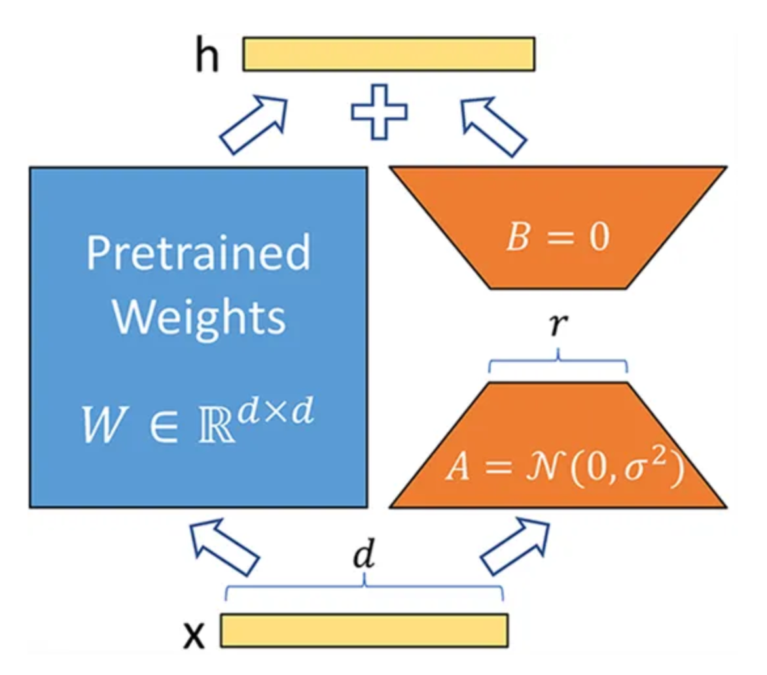


Low-Rank Adaptation: LoRA
Problem with Foundation Model Fine-tuning: Foundation Model are very big and computationally expensive to train and similarly to fine-tune. Parameter Efficient Fine-Tuning (PEFT) solves the problem by just allowing selective training of parameters.
LoRA: Incorporates trainable rank decomposition matrices into every layer of the transformer architecture and reduces trainable parameters for downstream tasks while keeping the pre-trained weights unchanged.
Radical Reduction of parameters: It can reduce the number of trainable parameters by up to 10,000 times and the required GPU memory by threefold, while still maintaining comparable performance
Original Image
Stable Diffusion Generated SGID Image
(Author's Implementation)
Notes:
Slide Title: Introducing LoRA
Today, we're delving into an innovative solution to address the challenges associated with fine-tuning large foundation models: LoRA.
Let's start by acknowledging the issue at hand. Foundation models are undeniably vast and require considerable computational resources for training and fine-tuning. It's a formidable task that often presents barriers to researchers and developers.
Enter LoRA – a solution that's as elegant as it is effective.
LoRA distinguishes itself by integrating trainable rank decomposition matrices into each layer of the model architecture. This strategic approach significantly reduces the number of trainable parameters while ensuring the preservation of pre-trained weights.
The impact of LoRA is profound. It achieves a remarkable reduction in parameters, boasting potential reductions of up to 10,000 times. Moreover, it optimizes GPU memory usage, leading to a threefold decrease in memory requirements.
In summary, LoRA emerges as a pivotal tool, streamlining the fine-tuning process for large models and enhancing accessibility for researchers and developers across diverse applications."

Slide 4
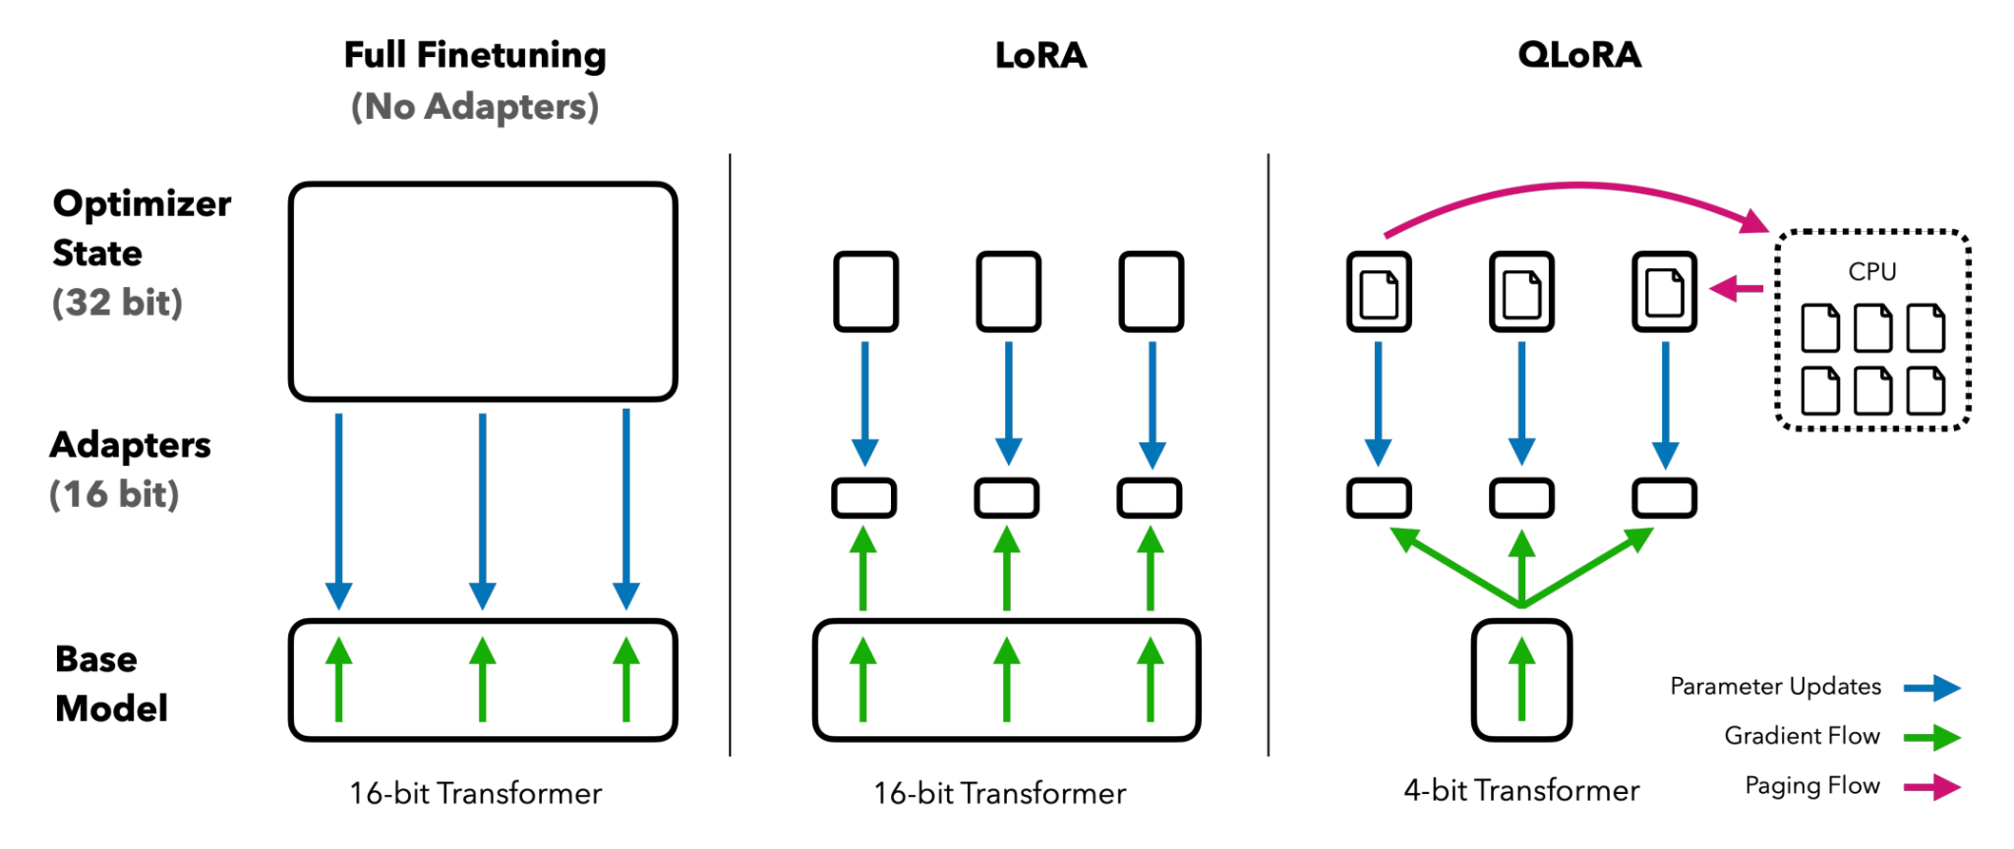
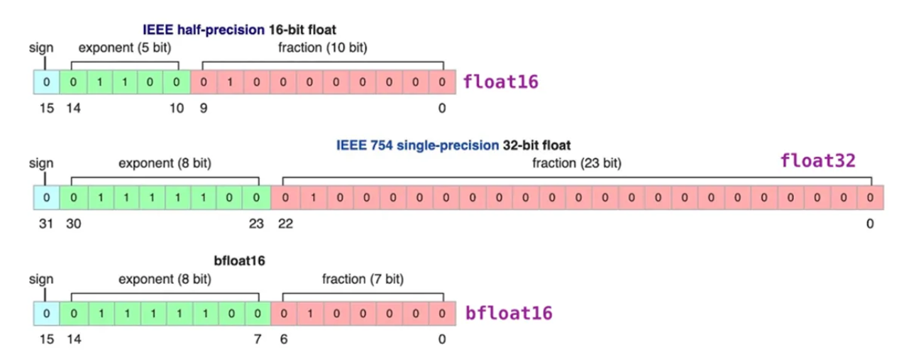
Efficient Finetuning of Quantized LLMs: QLoRA
Extension of LoRA: QLoRA acts as extension of
QLoRA, where it reduces the size of precision of
weight parameters from 32-bit format to 4-bit
format.
Multiple Options: QLoRA provide with multiple innovations that could be used to reduce the size of the model, including 4-bit NormalFloat, Double Quantization, and Paged Optimizers.
Notes:
Now let's address the challenge head-on. Fine-tuning these colossal models is no small feat, often demanding substantial computational resources and time. It's a hurdle that many researchers and developers face in their quest for optimized models.
Enter QLoRA – a game-changer in the world of fine-tuning.
QLoRA follows in the footsteps of its predecessor, LoRA, by incorporating trainable rank decomposition matrices into every layer of the model architecture. This innovative technique effectively reduces the number of trainable parameters while safeguarding the integrity of pre-trained weights.
But here's where QLoRA takes it up a notch.
QLoRA introduces a novel quantum-inspired approach to the rank decomposition process, leveraging principles from quantum computing to further enhance parameter efficiency. This groundbreaking method promises even greater reductions in trainable parameters and enhanced computational efficiency compared to its predecessor.
In essence, QLoRA represents the next frontier in fine-tuning large foundation models, offering researchers and developers an unparalleled tool for optimizing model performance and scalability.

Slide 5
Data Preparation
Embedding Storage
User Input Handling
Similarity Search and Response
Splitting raw text into multiple chunks
Embedding 1
Embedding 2
News articles are initially extracted from our dataset
and processed as raw texts. Subsequently, they are segmented into text chunks, and each chunk is assigned a vector embedding
Raw Text - News Articles
Text Chunks
Embedding 3
Text Chunks
Text Chunks
Text Chunks
Embedding 4
N Embeddings..
Notes:
Until now we have discussed how we had finetuned a Large Language model such as Mistral in our case to give better predictions on our custom financial dataset. (i.e. news articles)
Now let’s have a look at how the prompt retrieval and questions answering system is working in the project

Slide 6
Data Preparation
Embedding Storage
User Input Handling
Similarity Search and Response
Splitting raw text into multiple chunks
Embedding 1
Beam Search Caption
Embedding 2
Raw Text - News Articles
BLIP
Caption Generation
Text Chunks
Beam search sampling produces safer and more common captions
Text Chunks
Embedding 3
Text Chunks
Text Chunks
Embedding 4
Nucleus Caption
FAISS - Vector Database
N Embeddings..

Slide 7
Data Preparation
Embedding Storage
User Input Handling
Similarity Search and Response
Once a user enters a prompt it is formatted in a manner - Mistral 7B Instruct can handle
Example:
[INST]”Give me some detailed insights about META”[/INST]
Prompt Embedding
Chunk 1 Embedding
Translated to an Embedding
Chunk 2 Embedding
FAISS performs a similarity search results between the prompt embedding and the chunk embeddings stored in vector database

Slide 8

Data Preparation
Embedding Storage
User Input Handling
Similarity Search and Response
Recent Earnings Beat: Meta exceeded analyst expectations in their last earnings report, leading to a stock price increase……
Any LLM (In our case Gemini Pro)
Once a user enters a prompt it is formatted in a manner - Mistral 7B Instruct can handle
Example:
[INST]”Give me some detailed insights about META”[/INST]
Search of Relevant Chunks
Translated to an Embedding
Search of Relevant Chunks
Search of Relevant Chunks
FAISS performs a similarity search results between the prompt embedding and the chunk embeddings stored in vector database
Ranked Results from Semantic Search

Slide 9
Data Preparation
Embedding Storage
User Input Handling
Semantic Search and Response
Extract news articles from the dataset and break them into manageable text chunks to facilitate analysis.
Utilize Google's GEMINI model to assign vector embeddings to each text segment, capturing the nuanced context of the articles.
Employ the FAISS vector database to efficiently store the generated embeddings, ensuring quick access and retrieval.
Leverage FAISS's semantic similarity search capabilities to organize embeddings, enabling effective interaction with the data.
Standardize user prompts by formatting them according to system specifications, ensuring seamless integration.
Transform user prompts into vector embeddings suitable for semantic search, aligning them with the database structure for efficient retrieval.
Conduct semantic search operations using FAISS to retrieve the most relevant embeddings based on user prompts.
Utilize the Language Model to generate prompt replies, leveraging the contextual information captured by the retrieved embeddings for accurate and engaging responses.
Notes:
Here you can see the summary of all the steps discussed (2 sec pause).

Slide 10
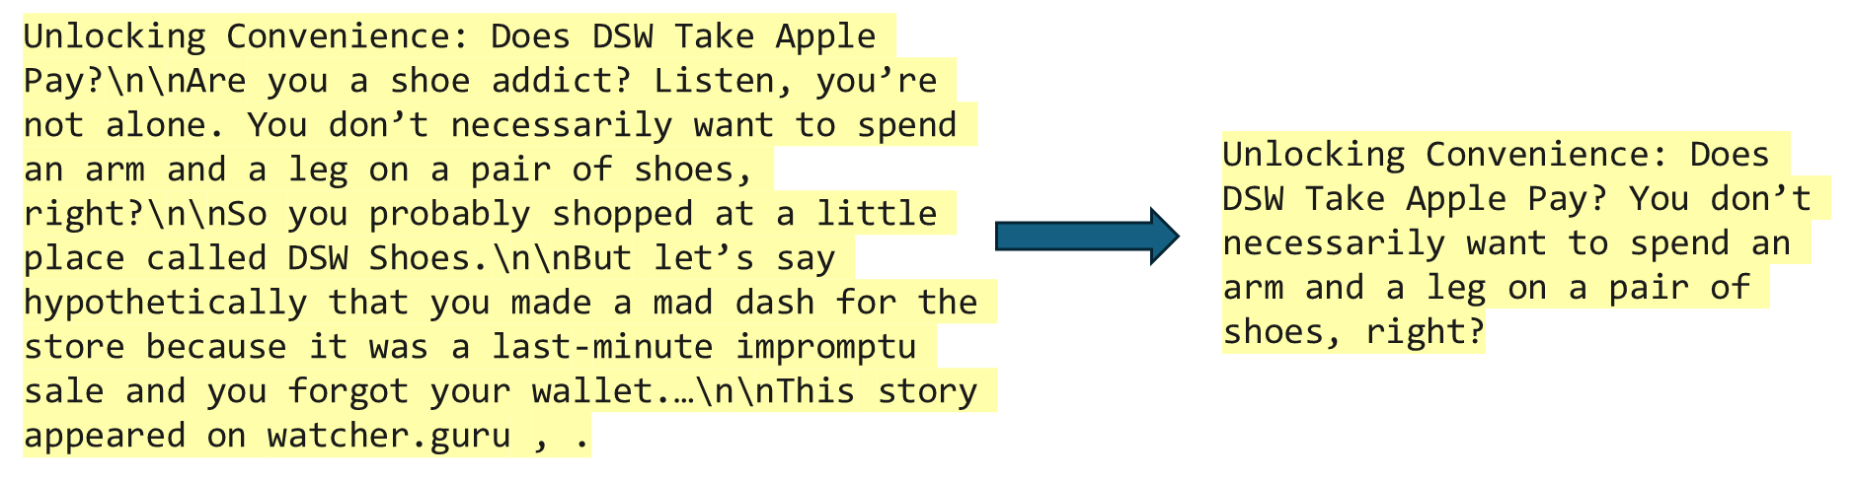
Financial News Summarize
•Scrapes financial news articles from NewsAPI
•Preprocesses News articles using Newspaper3k
•Generates summaries using Bert-Extractive-Summarizer
Notes:
To conclude, while we expected the SGID to improve classification model accuracy. It actually hindered the model performance when increased beyond certain proportions
The SGID images generated with our implementation were at times different from author’s implementation because not all details are explicitly mentioned in the report. Moreover, we also conclude that an over-reliance in SGID based techniques can actually hinder model performance careful optimizations are required to achieve desired results
Despite challenges, SGID can be beneficial in scenarios where surpassing benchmarks is more important compared to computation costs.

Slide 11
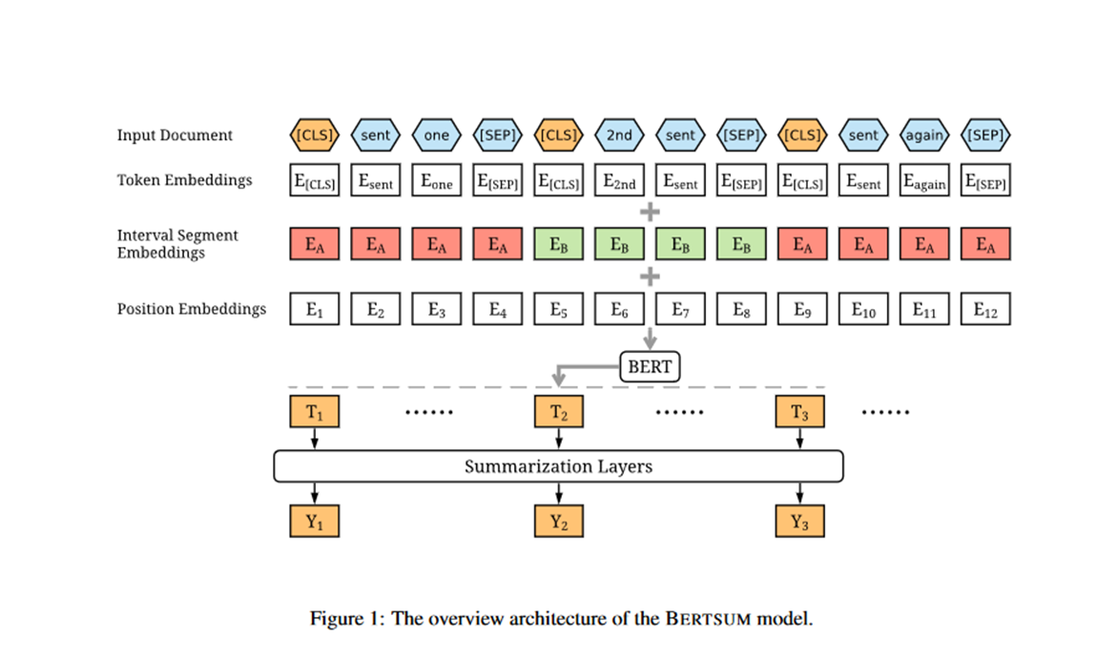
BERT (Bidirectional Encoder Representations) Summariser
•Tokenization and stop word removal
•Contextualized representation using BERT
•Extraction of relevant sentences and phrases
•Integration with Newspaper3k for article parsing

Slide 12
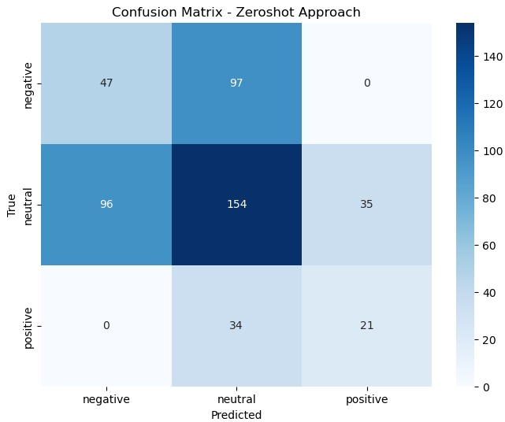
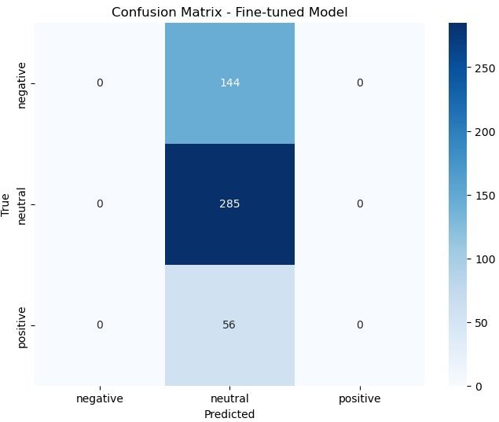
Results and Benchmark 1/2
Confusion Matrix for Mistral 7B after supervised fine-tuning on Finanical Phrase Bank dataset
Confusion Matrix for Mistral 7B Instruct (Zero shot model) on Finanical Phrase Bank dataset
Notes:
Now talking out accuracy and evaluation metrics…..

Slide 13
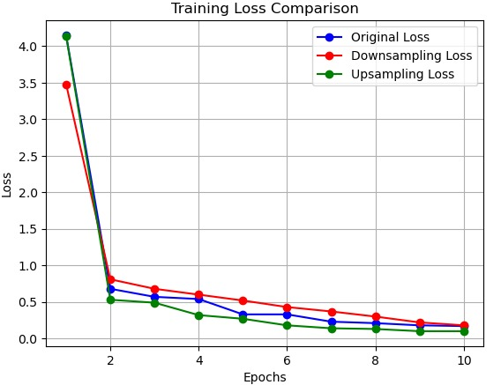
Results and Benchmark 2/2
Sentimental Label | Accuracy
Positive | 7%
Neutral | 28.1%
Negative | 62.5%
using the zero-shot technique with Mistral to predict sentiments on the Financial Phrasebank dataset yielded an overall accuracy of 23%.
Notably, accuracy for negative labels remained the highest (62%) compared to positive or neutral labels.
Training Losses Observed with Different Approaches While Finetuning Mistral

Slide 14
Critical Analysis
Performance Issues: Despite SFT application, only achieved 23% accuracy on Financial PhraseBank dataset
Imbalance in Class Accuracy: Favoring negative sentiments; attributed to data class imbalances
Ineffective Class Balancing Techniques: Down-sampling, up-sampling failed to improve; confusion matrices show persistent skew
Challenges with Financial Language: Complexity and nuances of financial language; Mistral-7B model's potential lack of domain-specific tuning
Limitations of Data Manipulation Techniques: Hindered by dataset noise, variability; risk of losing crucial information.
Notes:
Let's start by addressing the elephant in the room: our performance issues. Despite our best efforts, we're only seeing a 23% accuracy rate on the Financial PhraseBank dataset, even after applying sophisticated techniques like SFT.
Moving on, we've noticed a significant imbalance in class accuracy, with negative sentiments consistently outperforming positive or neutral ones. This skew is largely due to inherent class imbalances in our training data, which have been a tough nut to crack.
Now, onto our attempts to tackle this issue with class balancing techniques. Unfortunately, neither down-sampling nor up-sampling seem to be cutting it. Our confusion matrices continue to show a stubborn skew towards neutral classifications, indicating that these methods aren't effectively helping our model generalize across sentiment categories.
And then there's the matter of financial language. It's a beast of its own, isn't it? The complexity and nuances inherent in financial jargon are posing some serious challenges for our analysis. To add to the complexity, our Mistral-7B model might not have been initially tailored for these financial contexts, which calls for some domain-specific tuning or pretraining.
Lastly, let's talk about data manipulation techniques. While we've tried our best with down-sampling and up-sampling, we've hit roadblocks due to dataset noise and variability. There's a real risk of losing crucial information in the process, which, as you can imagine, isn't ideal for our learning efficacy.
So, there you have it—multiple hurdles we're facing in our quest to improve sentiment analysis in financial texts. It's clear we've got our work cut out for us, but with perseverance and strategic adjustments, I'm confident we can overcome these challenges and enhance our decision-making processes in finance. Thank you.

Slide 15
Conclusion
This project aims to democratize access to stock market analysis through cutting-edge NLP technologies and large language models like Mistral and Gemma. By converting complex financial data into user-friendly formats, it provides comprehensive insights, enabling users to make informed investment decisions
Rigorous real-world evaluations ensure the accuracy and effectiveness of the market summaries and sentiment analyses provided.
Despite significant progress, challenges like class imbalance and model generalization remain, highlighting the need for ongoing research and improvement in financial sentiment analysis.
Notes:
Democratizing Access to Stock Market Analysis: The project leverages advanced NLP technologies and large language models like Mistral and Gemma to make stock market analysis accessible to a wider audience. Complex financial data is transformed into easy-to-understand formats, providing users with comprehensive insights for making informed investment decisions.
Rigorous Real-World Evaluations: The accuracy and effectiveness of market summaries and sentiment analyses are rigorously evaluated in real-world settings, ensuring reliability and trustworthiness in the information provided to users.
Ongoing Challenges: Despite significant progress, challenges such as class imbalance and model generalization persist. These challenges underscore the necessity for continued research and improvement in financial sentiment analysis, aiming to enhance the overall effectiveness and usability of the platform

